Slide 1

Object Oriented Python

Slide 2
INDEX
Introduction
Defining a Class
Special attributes
Controlling access to attributes
Private attributes
Constructor with default arguments
Destructor
Composition
Data abstraction and Information hiding
Standard library

Slide 3
INTRODUCTION
In object-oriented programming, a class is an extensible template for creating objects, providing initial values for state (member variables) and implementations of behavior (member functions, methods).
Definitions:
Object:
An object stores its state in fields (variables in some programming languages) and exposes its behaviour through methods (functions in some programming languages).
Class:
A class is the blueprint from which individual objects are created.

Slide 4
INTRODUCTION
Advantage:
  Re-usability :
    The set of codes can be defined in single time and can use by multiple times.
  Information hiding :
  Data will not be required for end users, because going to access only methods.
  Extensibility :
  If new behaviour has to be add, easy to add.

Slide 5
INTRODUCTION
General Properties of Classes
  Methods
    Invoked in response to messages sent to objects
  Object interface
    Client-oriented
      Clients do not need to be familiar with implementation of class
  Enable software reuse
    Classes may be derived from other classes
    Classes may contain objects of other classes

Slide 6
DEFINING A CLASS
  Class header
    Keyword class begins definition
      Followed by name of class and colon (:)
  Body of class
    Indented block of code
  Documentation string
    Describes the class
    Optional
    Appears immediately after class header.

Slide 7
DEFINING A CLASS
  Constructor method __init__
    Executes each time an object is created
    Initialize attributes of class
    Returns None
  Object reference
    All methods must at least specify this one parameter
    Represents object of class from which a method is called
    Called self by convention

Slide 8
DEFINING A CLASS
1 # Fig: class.py
2 # Opening and writing to a file.
3
4 class MyClass:
‘’’ A simple class for example’’’
I = 123
def function():
return “hello world”
Creating Objects
x = MyClass()
creates a new instance of the class and assigns this object to the local variable x.

Slide 9
DEFINING A CLASS
1 # Fig. 7.1: Time1.py
2 # Simple definition of class Time.
3
4 class Time:
5 """Time abstract data type (ADT) definition"""
6
7 def __init__( self ):
8 """Initializes hour, minute and second to zero"""
9
10 self.hour = 0 # 0-23
11 self.minute = 0 # 0-59
12 self.second = 0 # 0-59
13
14 def printMilitary( self ):
15 """Prints object of class Time in military format"""
16
17 print "%.2d:%.2d:%.2d" % \
18 ( self.hour, self.minute, self.second ),
19
Class header
Constructor method
Variables initialized and entered in class’s namespace
Object reference passed to each method

Slide 10
DEFINING A CLASS
The attributes of time1 are:
time1.hour: 0
time1.minute: 0
time1.second: 0
Calling method printMilitary: 00:00:00
Calling method printStandard: 12:00:00 AM
Changing time1's hour attribute...
Calling method printMilitary after alteration: 25:00:00

Slide 11
SPECIAL ATTRIBUTES
  Python’s ability to provide information about itself.
  Special attributes:
    Belong to classes or objects of classes.
    Created by Python when class is defined or object is created.
    All classes have attributes in common.
    Provide information about the class or object of a class to which they belong.
    Preceded and followed by double underscores (__).

Slide 12
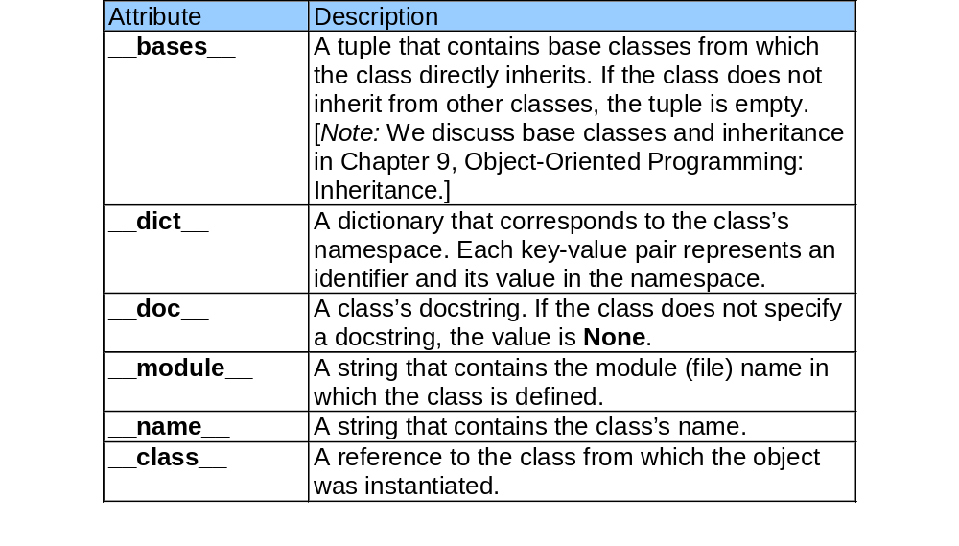
SPECIAL ATTRIBUTES

Slide 13
SPECIAL ATTRIBUTES
Python 2.2b2 (#26, Nov 16 2001, 11:44:11) [MSC 32 bit (Intel)] on win32
Type "help", "copyright", "credits" or "license" for more information.
>>>
>>> from Time1 import Time
>>> print Time.__bases__
()
>>> print Time.__dict__
{'printMilitary': <function printMilitary at 0x0079BF80>, '__module__': 'Time1', '__doc__': 'Time abstract data type (ADT) definition', '__init__': <function __init__ at 0x0077AB00>, 'printStandard': <function printStandard at 0x00769990>}
>>>
>>> print Time.__doc__
Time abstract data type (ADT) definition
>>> print Time.__module__
Time1
>>> print Time.__name__
Time
>>> time1 = Time()
>>> print time1.__class__
Time1.Time
__dict__ special attribute contains dictionary of items in class namespace
__class__ has information about class from which object was instantiated

Slide 14
PRIVATE ATTRIBUTES
Private attributes
  Data and attributes not to be accessed by clients of a class
  Private attributes preceded with double underscore (__)
    Causes Python to perform name mangling
      Changes name of attribute to include information about the class
      For example, attribute __hour in class Time becomes _Time__hour

Slide 15
PRIVATE ATTRIBUTES
1 # Fig. 7.11: Private.py
2 # Class with private data members.
3
4 class PrivateClass:
5 """Class that contains public and private data"""
6
7 def __init__( self ):
8 """Private class, contains public and private data members"""
9
10 self.publicData = "public" # public data member
11 self.__privateData = "private" # private data member

Slide 16
DEFAULT ARGUMENTS WITH CONSTRUCTORS
Default constructors
  Default values provided for all arguments
    Constructor may be invoked with no arguments
  Default arguments
    Specify initial values for object attributes
    Used if client does not specify an argument at construction time
    Keyword arguments
      Client may specify values for only certain, named arguments

Slide 17
DEFAULT ARGUMENTS WITH CONSTRUCTORS
1 # Fig: 7.13: Time3.py
2 # Class Time with default constructor.
3
4 class Time:
5 """Class Time with default constructor"""
6
7 def __init__( self, hour = 0, minute = 0, second = 0 ):
8 """Time constructor initializes each data member to zero"""
9
10 self.setTime( hour, minute, second )
11
12 def setTime( self, hour, minute, second ):
13 """Set values of hour, minute, and second"""
14
15 self.setHour( hour )
16 self.setMinute( minute )
17 self.setSecond( second )
18
19 def setHour( self, hour ):
20 """Set hour value"""
21
22 if 0 <= hour < 24:
23 self.__hour = hour
24 else:
25 raise ValueError, "Invalid hour value: %d" % hour
26
hour, minute and second are all defaulted to 0 if the client does not provide values

Slide 18
DESTRUCTORS
  Method is named __del__
  Executed when object is destroyed
    No more references to object exist
  Performs termination housekeeping before Python reclaims object memory
    Typically used to close network or database connections

Slide 19
DESTRUCTORS
1 # Fig. 7.15: EmployeeWithClassAttribute.py
2 # Class Employee with class attribute count.
3
4 class Employee:
5 """Represents an employee"""
6
7 count = 0 # class attribute
8
9 def __init__( self, first, last ):
10 """Initializes firstName, lastName and increments count"""
11
12 self.firstName = first
13 self.lastName = last
14
15 Employee.count += 1 # increment class attribute
16
17 print "Employee constructor for %s, %s" \
18 % ( self.lastName, self.firstName )
19
20 def __del__( self ):
21 """Decrements count and prints message"""
22
23 Employee.count -= 1 # decrement class attribute
24
25 print "Employee destructor for %s, %s" \
26 % ( self.lastName, self.firstName )
Class attribute count is defined in class body
Constructor increments value of count when an object is created
Destructor decrements value of count when an object is destroyed

Slide 20
DESTRUCTORS
1 # Fig. 7.16: fig07_16.py
2 # Demonstrating class attribute access.
3
4 from EmployeeWithClassAttribute import Employee
5
6 print "Number of employees before instantiation is", \
7 Employee.count
8
9 # create two Employee objects
10 employee1 = Employee( "Susan", "Baker" )
11 employee2 = Employee( "Robert", "Jones" )
12 employee3 = employee1
13
14 print "Number of employees after instantiation is", \
15 employee1.count
16
17 # explicitly delete employee objects by removing references
18 del employee1
19 del employee2
20 del employee3
21
22 print "Number of employees after deletion is", \
23 Employee.count
employee3 is bound to an existing object. No new object is created and the constructor is not invoked
del keyword implicitly deletes each object by removing references and causes the destructor to execute each time an object is destroyed

Slide 21
DESTRUCTORS
Number of employees before instantiation is 0
Employee constructor for Baker, Susan
Employee constructor for Jones, Robert
Number of employees after instantiation is 2
Employee destructor for Jones, Robert
Employee destructor for Baker, Susan
Number of employees after deletion is 0

Slide 22
COMPOSITION
  Defining a class with objects of other classes
    The attributes themselves are references to other objects

Slide 23
COMPOSITION
1 # Fig. 7.17: Date.py
2 # Definition of class Date.
3
4 class Date:
5 """Class that represents dates"""
6
7 # class attribute lists number of days in each month
8 daysPerMonth = [
9 0, 31, 28, 31, 30, 31, 30, 31, 31, 30, 31, 30, 31 ]
10
11 def __init__( self, month, day, year ):
12 """Constructor for class Date"""
13
14 if 0 < month <= 12: # validate month
15 self.month = month
16 else:
17 raise ValueError, "Invalid value for month: %d" % month
18
19 if year >= 0: # validate year
20 self.year = year
21 else:
22 raise ValueError, "Invalid value for year: %y" % year
23
24 self.day = self.checkDay( day ) # validate day
25
26 print "Date constructor:",
27 self.display()
28

Slide 24
COMPOSITION
29 def __del__( self ):
30 """Prints message when called"""
31
32 print "Date object about to be destroyed:",
33 self.display()
34
35 def display( self ):
36 """Prints Date information"""
37
38 print "%d/%d/%d" % ( self.month, self.day, self.year )
39
40 def checkDay( self, testDay ):
41 """Validates day of the month"""
42
43 # validate day, test for leap year
44 if 0 < testDay <= Date.daysPerMonth[ self.month ]:
45 return testDay
46 elif self.month == 2 and testDay == 29 and \
47 ( self.year % 400 == 0 or
48 self.year % 100 != 0 and self.year % 4 == 0 ):
49 return testDay
50 else:
51 raise ValueError, "Invalid day: %d for month: %d" % \
52 ( testDay, self.month )

Slide 25
COMPOSITION
1 # Fig. 7.18: EmployeeComposition.py
2 # Definition of Employee class with composite members.
3
4 from Date import Date
5
6 class Employee:
7 """Employee class with Date attributes"""
8
9 def __init__( self, firstName, lastName, birthMonth,
10 birthDay, birthYear, hireMonth, hireDay, hireYear ):
11 """Constructor for class Employee"""
12
13 self.birthDate = Date( birthMonth, birthDay, birthYear )
14 self.hireDate = Date( hireMonth, hireDay, hireYear )
15
16 self.lastName = lastName
17 self.firstName = firstName
18
19 print "Employee constructor: %s, %s" \
20 % ( self.lastName, self.firstName )
21
22 def __del__( self ):
23 """Called before Employee destruction"""
24
25 print "Employee object about to be destroyed: %s, %s" \
26 % ( self.lastName, self.firstName )
27
Attributes birthDate and hireDate are Date objects

Slide 26
COMPOSITION
1 # Fig. 7.19: fig07_19.py
2 # Demonstrating composition: an object with member objects.
3
4 from Date import Date
5 from EmployeeComposition import Employee
6
7 employee = Employee( "Bob", "Jones", 7, 24, 1949, 3, 12, 1988 )
8 print
9
10 employee.display()
11 print
Employee constructor creates an Employee object and uses information in parameters to create Date objects specifying the employee’s date of hire and date of birth
Date constructor: 7/24/1949
Date constructor: 3/12/1988
Employee constructor: Jones, Bob
Jones, Bob
Hired: 3/12/1988
Birth date: 7/24/1949
Employee object about to be destroyed: Jones, Bob
Date object about to be destroyed: 3/12/1988
Date object about to be destroyed: 7/24/1949

Slide 27
DATA ABSTRACTION AND INFORMATION HIDING
Information Hiding
  Classes hide implementation details from their clients
Data Abstraction
  Object-oriented languages create data types and express interactions between objects of data types
  Objects know what capabilities a structure offers, but not how the structure is implemented
  Abstract Data Types
    Provide formalizations of data to improve development process
    Representations of real world notions

Slide 28
STANDARD LIBRARY
Python standard library
  Contains hundreds of predefined classes
    Well-defined, tested and documented
  Promote Rapid Application Development
    Programmers build applications using predefined classes
  Improve program debugging and maintenance
Example library module
  re, time, os, sys, etc….

